Slide 1
Enhancing Network Resilience against Distributed Denial-of-Service (DDoS) Attacks
By Bhavani Siva Jyothi

Slide 2
ABSTRACT
The appearance of malicious apps and web url is a serious threat to the Android platform. Most types of network interfaces based on the integrated functions, steal users' personal information and start the attack operations. In this paper, we propose an effective and automatic malware detection method using the text semantics of network traffic. In particular, we consider each HTTP flow generated by mobile apps and url data as a text document, which can be processed by natural language processing to extract text-level features. Later, the use of network traffic is used to create a useful malware detection model. We examine the traffic flow header using N-gram method from the natural language processing (NLP). Then, we propose an automatic feature selection algorithm based on chi-square test to identify meaningful features. It is used to determine whether there is a significant association between the two variables.We propose a novel solution to perform malware detection using NLP methods by treating mobile traffic as documents. We apply an automatic feature selection algorithm based on N-gram sequence to obtain meaningful features from the semantics of traffic flows. Our methods reveal some malware that can prevent detection of antiviral scanners. In addition, we design a detection system to drive traffic to your own-institutional enterprise network, home network, and url dataset. Integrating the system connected to the computer to find suspicious network behaviors.

Slide 3
INTRODUCTION
MOTIVATION
The appearance of malicious apps is a serious threat to the Android platform.
Most types of network interfaces based on the integrated functions, steal users personal information and start the attack operations.
In this paper, we propose an effective and automatic malware detection method using the text semantics of network traffic.
In particular, we consider each HTTP flow generated by mobile apps as a text document, which can be processed by natural language processing to extract text-level features.
Later, the use of network traffic is used to create a useful malware detection model

Slide 4
The objectives of this research are as follows:
To analyze the vulnerabilities inherent in network infrastructures that make them susceptible to DDoS attacks.
To develop and implement proactive measures to detect and respond to DDoS attacks effectively.

Slide 5
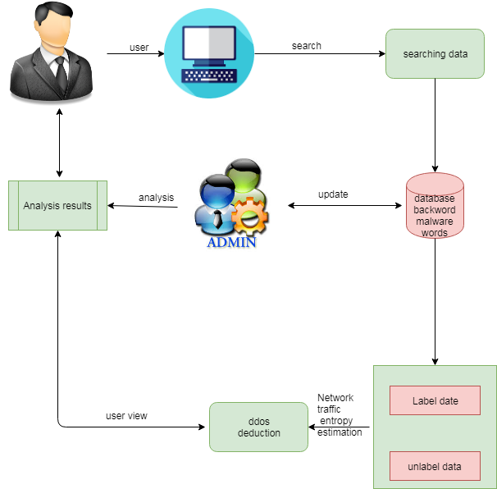
Architecture

Slide 6
EXISTING SYSTEM:
The first phase of their approach consists of dividing the incoming network traffic into three type of protocols TCP, UDP or Other. Then classifying it into normal or anomaly traffic. In the second stage a multi-class algorithm classify the anomaly detected in the first phase to identify the attacks class in order to choose the appropriate intervention. Two public data sets are used for experiments in this paper namely the UNSW-NB15 and the NSL-KDD Several approaches have been proposed for detecting DDoS attack. Information theory and machine learning are the The performances of network intrusion detection approaches, in general, rely on the distribution characteristics of the under laying network traffic data used for assessment. The DDoS detection approaches in the literature are under two main categories unsupervised approaches and supervised approaches. Depending on the benchmark data sets used, unsupervised approaches often suffer from high false positive rate and supervised approach cannot handle large amount of network traffic data and their performances are often limited by noisy and irrelevant network data. Therefore, the need of combining both, supervised and unsupervised approaches arises to overcome DDoS detection issue.

Slide 7
Existing System Disadvantages:
The datasets above are split into train subsets and test subsets using a configuration of 60% and 40% respectively.
The proposed approach consists of five major steps: Datasets preprocesing, estimation of network traffic Entropy, online co- clustering, information gain ratio.
The aim of splitting the anomalous network traffic is to reduce the amount of data to be classified by excluding the normal cluster for the classification

Slide 8
SYSTEM REQUIREMENTS:
IDE | OS
1. Python 2. Django 3. MySql 4. MySqlclient 5. WampServer 2.4 | Works on windows operating system
HARDWARE REQUIREMENTS
:
Processor | Intel I3 and above
DISK Space | 10GB
RAM | 4GB and higher

Slide 9
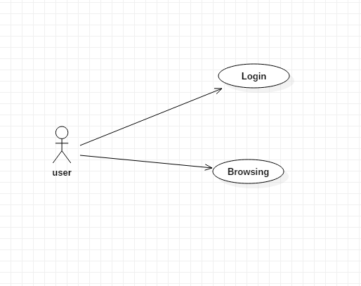
UML Diagrams
Use case

Slide 10
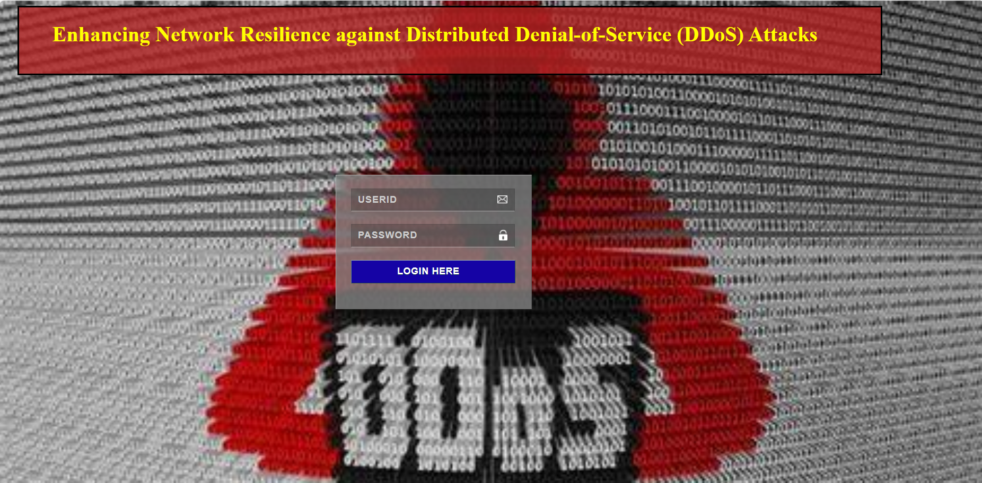
Results

Slide 11
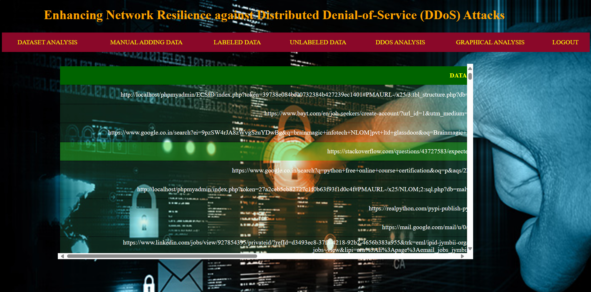
Dataset Analysing

Slide 12
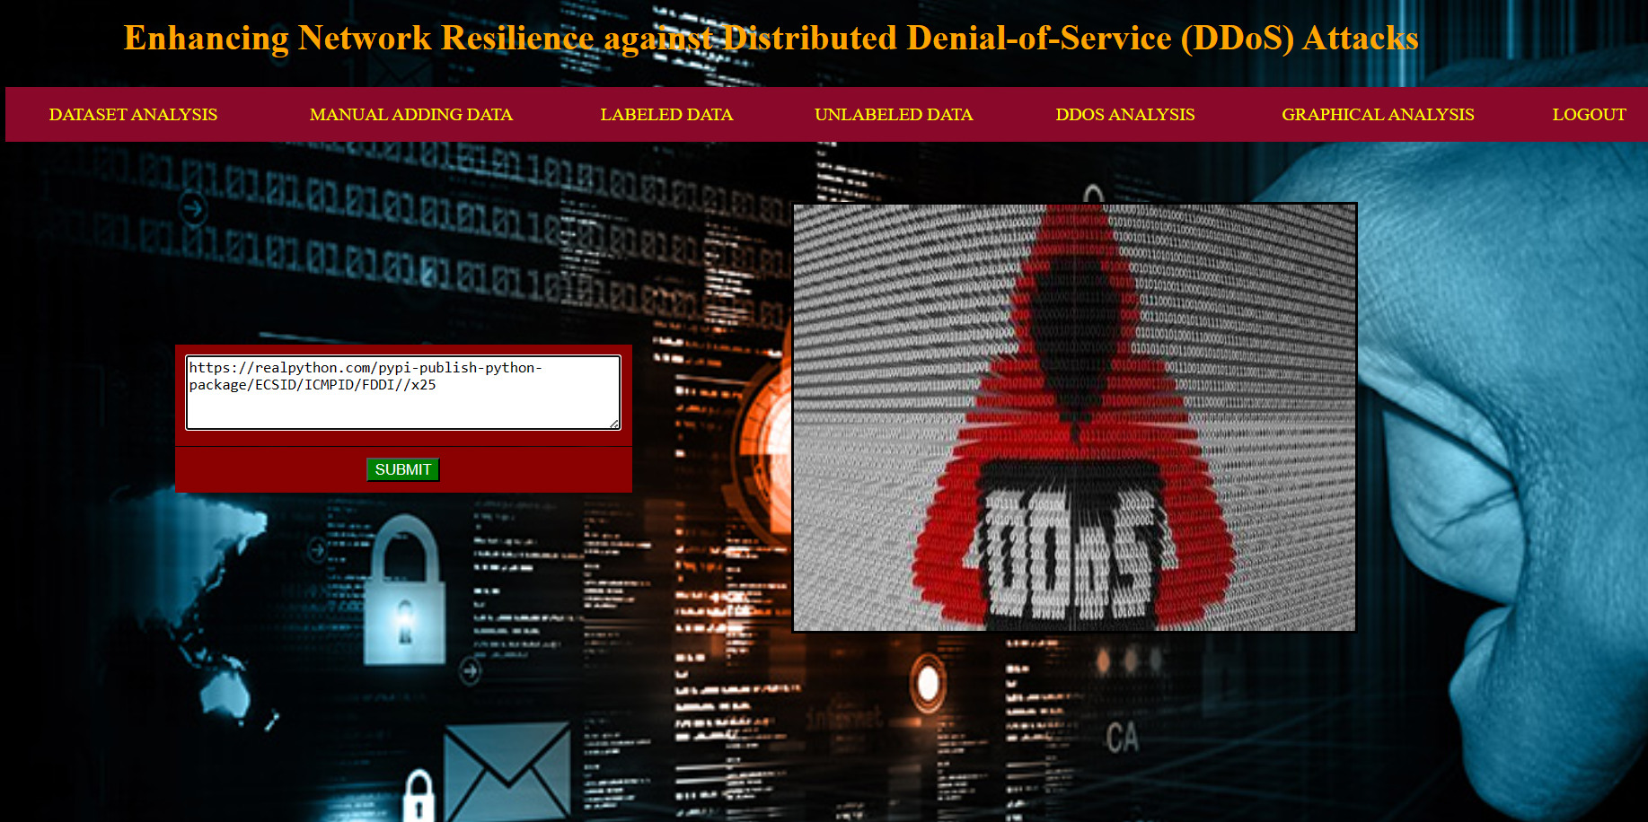
Manual Data (Url or apps data) Adding

Slide 13
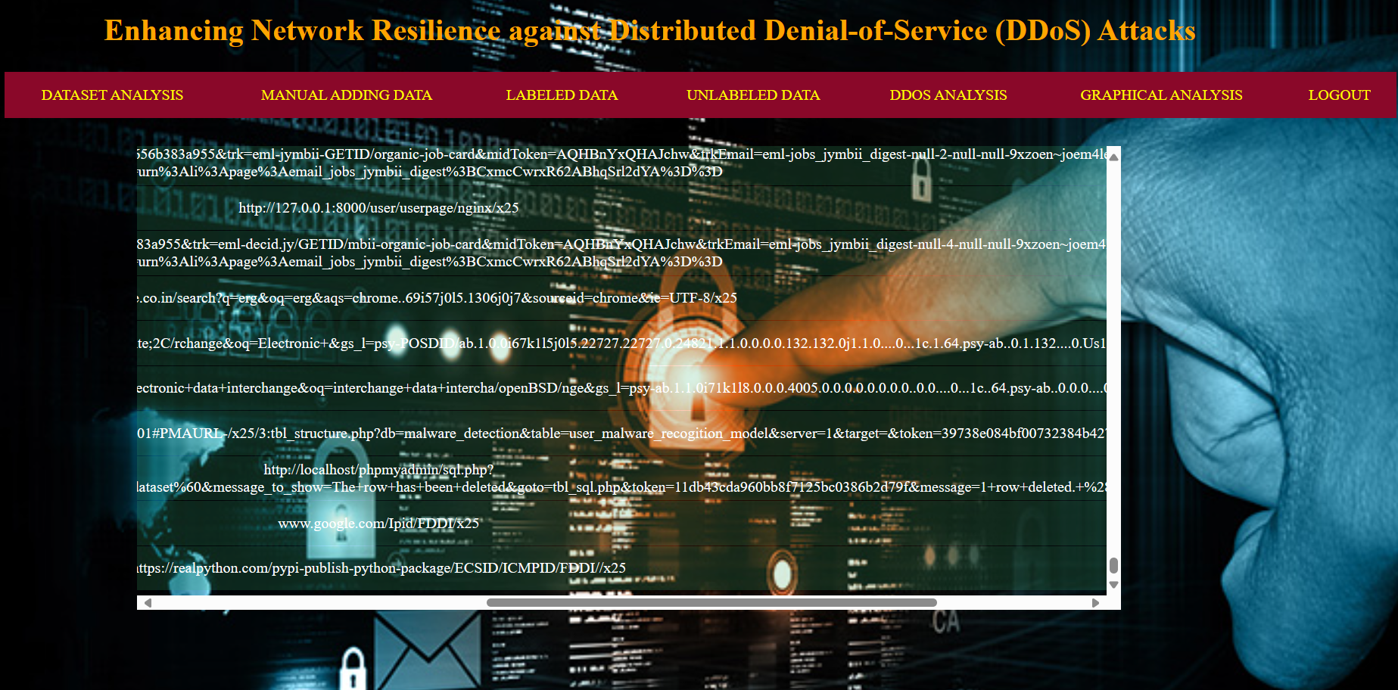
Label Data(Malware (Ddos Attacks))

Slide 14
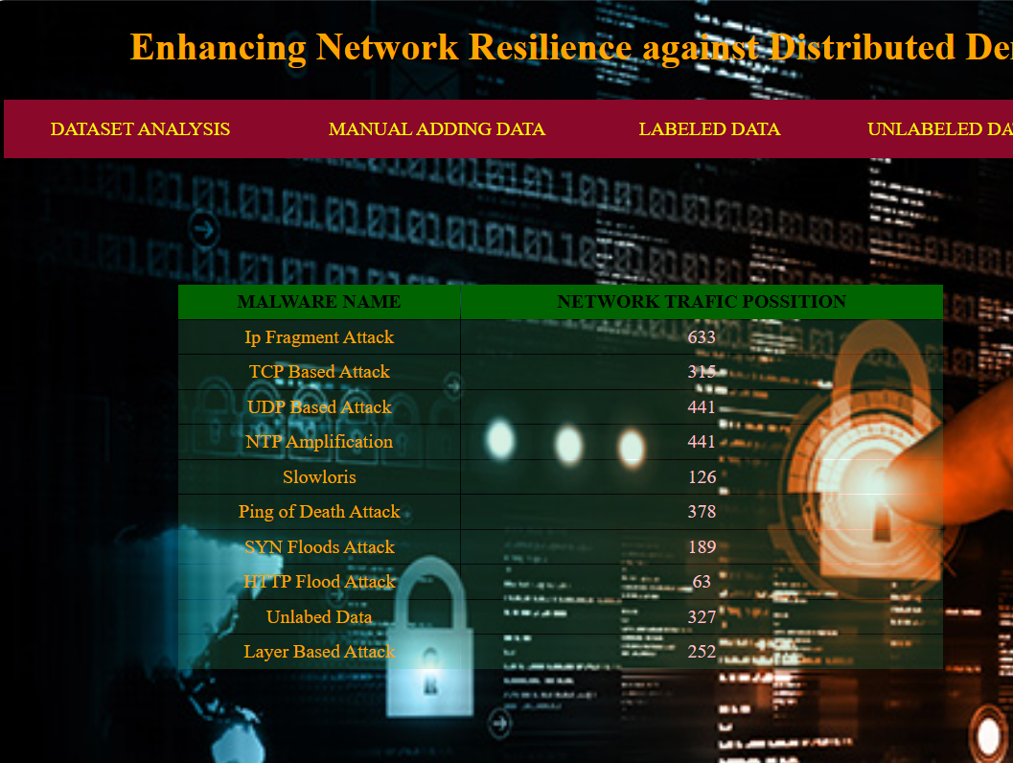
DDOS Attacks Analysing

Slide 15
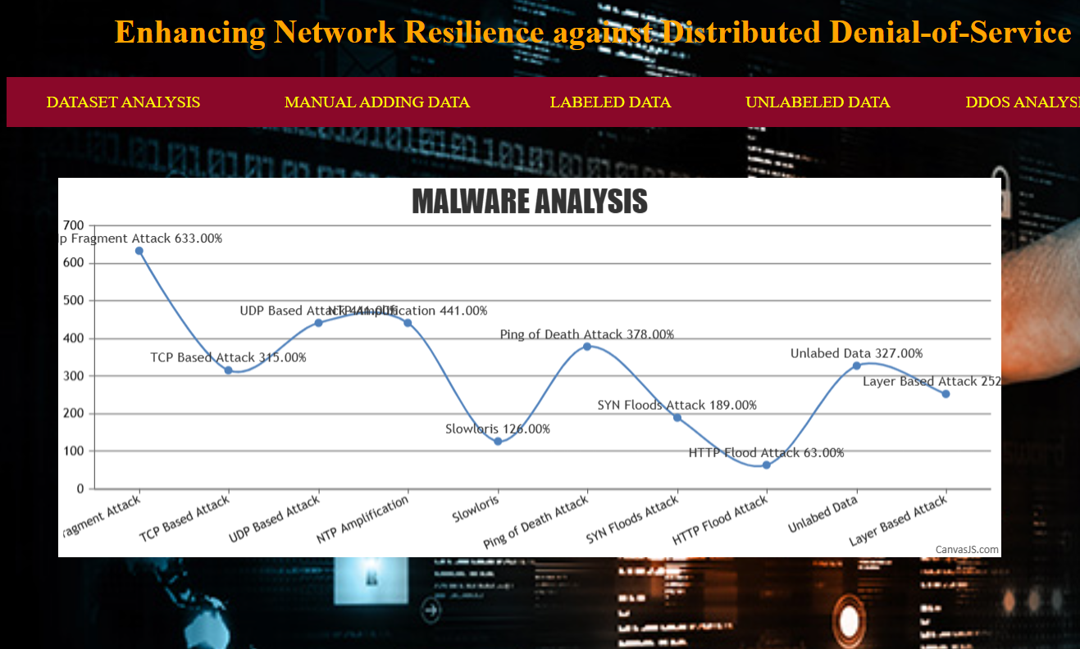
DDOS Attacks Spline Chart

Slide 16
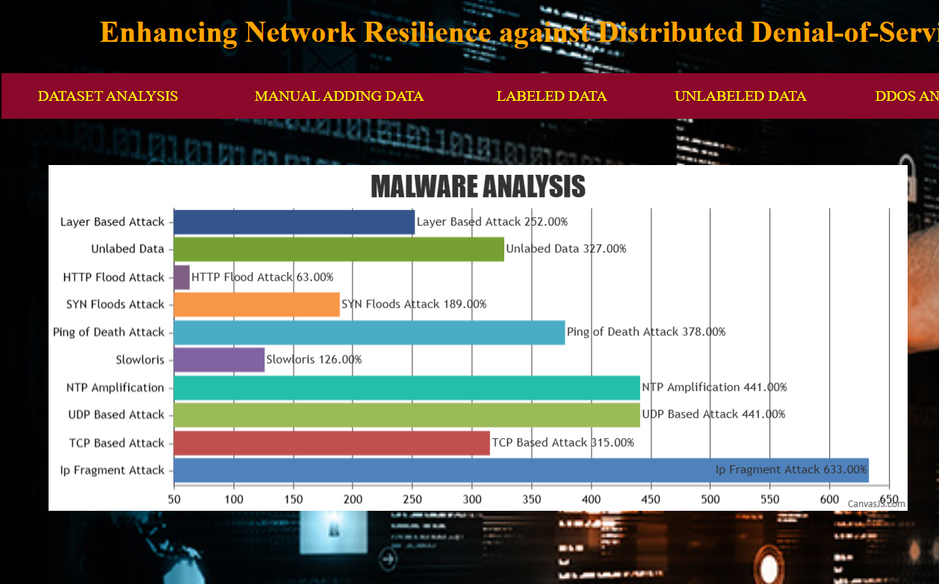
DDOS Attacks Bar Chart

Slide 17
conclusion
Android is a new and fastest growing threat to malware. Currently, many research methods and antivirus scanners are not hazardous to the growing size and diversity of mobile malware. As a solution, we introduce a solution for mobile malware detection using network traffic flows, which assumes that each HTTP flow is a document and analyzes HTTP flow requests using NLP string analysis. The N-Gram line generation, feature selection algorithm, and SVM algorithm are used to create a useful malware detection model. Our evaluation demonstrates the efficiency of this solution, and our trained model greatly improves existing approaches and identifies malicious leaks with some false warnings. The harmful detection rate is 99.15%, but the wrong rate for harmful traffic is 0.45%. Using the newly discovered malware further verifies the performance of the proposed system. When used in real environments, the sample can detect 54.81% of harmful applications, which is better than other popular anti-virus scanners. As a result of the test, we show that malware models can detect our model, which does not prevent detecting other virus scanners. Obtaining basically new malicious models VirusTotal detection reports are also possible. Added, Once new tablets are added to training samples, we will Please re-train and refresh and update the new malware.

Slide 18
REFERENCES
[1] Gozde Karatas, Onder Demir, And Ozgur Koray Sahingoz, “Increasing The Performance Of Machine Learning-Based Idss On An Imbalanced And Up-To-Date Dataset” In Department Of Mathematics And Computer Sciences, Faculty Of Science And Literature, Istanbul Kultur University, Istanbul, Turkey
[2] Laurens D’hooge, T. Wauters, B. Volckaert, and F. De Turck, ‘‘Classificationhardness for supervised learners on 20 years of intrusion detection data,’’IEEE Access, vol. 7, pp. 167455–167469, 2019.
[3] Akhtar, Z. (2021). Malware Detection and Analysis: Challenges and Research Opportunities. ArXiv, abs/2101.08429.
[4] Tongtong Su, H. Sun, J. Zhu, S. Wang and Y. Li, "BAT: Deep Learning Methods on Network Intrusion Detection Using NSL-KDD Dataset," in IEEE Access, vol. 8, pp. 29575-29585, 2020, doi: 10.1109/ACCESS.2020.2972627.
[5] Moreno Ambrosin, Mauro Conti , Fabio De Gaspari, and Radha Poovendran, “Lineswitch: Efficiently managing switch flow in software-defined networking while effectively tackling dos attacks,” in Proc. 10th ACM Symp. Inf. Comput. Commun. Security, Singapore, 2015, pp. 639–
[6] Narmeen Zakaria Bawany, Jawwad A. Shamsi, Khaled Salah, “DDoS Attack Detection and Mitigation Using SDN Methods, Practices, and Solutions”, Arabian Journal for Science and
Engineering, February 2017, Volume 42, Issue 2, pp 425–441
[7] Tommy Chin, Xenia Mountrouidou, Xiangyang Li, Kaiqi Xiong, “An SDN-Supported
Collaborative Approach for DDoS Flooding Detection and Containment,” in Proc. IEEE Mil.
Commun. Conf. (MILCOM), Tampa, FL, USA, 2015, pp. 659–664.
[8] Mohan Dhawan, Rishabh Poddar, Kshiteej Mahajan, Vijay Mann, “Sphinx: Detecting security attacks in software-defined networks,” in Proc. NDSS, San Diego, CA, USA, 2015.
[9] Reza Mohammadi, Reza Javidan, and Mauro Conti, “SLICOTS: An SDN-Based Lightweight
Countermeasure for TCP SYN Flooding Attacks”, IEEE TRANSACTIONS ON NETWORK
AND SERVICE MANAGEMENT, VOL. 14, NO. 2, JUNE 2017
[10] Nhu-Ngoc Dao, Junho Park, Minho Park, Sungrae Cho, "A Feasible Method to combat against DDoS Attack in SDN Network," International Conference on Information Networking (ICOIN)

